Slide 1
6883 Financial Computing Group Project
Event Study: Earning Announcements and Stock Prices
Valentine Perevalov Aum Biyani Yuying Song
Zhuli Wang Feixian Wu Qi Wu

Slide 2
Content
PART 1 ----------- Structure Introduction
PART 2 ----------- Read and Process data
PART 3 ----------- Classes, Methods, and Calculations
PART 4 ----------- GNU plot & Menu
PART 5 ----------- Optimization
Conclusion

Slide 3
Part 1 - Structure Introduction

Slide 4
Executive Summary
Objective: This project evaluates the impact of quarterly earnings reports on stock price movements using a data-driven approach, encompassing sorting, bootstrapping, and statistical analysis.
Key Components:
Data Retrieval:
Utilizes liburl to obtain historical price data for Russell 3000 stocks and IWV (ETF benchmark) from eodhistoricaldata.com.
Validates user input for selecting 2N+1 days of historical data (N ≥ 60 and N ≤ 90).
Class Structure:
Implements classes to handle EPS estimates and price information for stocks.
Utilizes STL map and vector to store stock information.
Calculations:
Sorts stocks into three groups (Beat, Meet, Miss Estimate) based on surprise% from Q2 2023 earnings.
Implements bootstrapping to calculate abnormal returns (AR), average daily abnormal returns (AAR), and cumulative abnormal returns (CAAR).
Menu Options: User-friendly menu with options to:
Retrieve historical price data.
Access detailed stock information.
Display AAR, AAR-STD, CAAR, and CAAR-STD for a group.
Visualize CAAR for all three groups using gnuplot.
Exit the program.
Graphical Representation: Utilizes gnuplot to visually represent CAAR for all three groups in a single graph.
Key Takeaway: The project seeks to provide actionable insights for investors and analysts by exploring the relationship between earnings reports and stock price movements.

Slide 5
Structure
Data
Model
Visualization
Preprocess earning announcement data
Define day 0, start date and end date of data
Retrieve data from EODHistoricalData using libcurl
Randomly select 30 stocks for each group
Calculate log returns, AR, AAR, CAAR
Repeat for 40 times and calculate mean and standard deviation of AAR, CAAR
Plot CAAR for 3 groups using gnuplot
Optimization: Multithreading
Design and implement menu
Slides designing

Slide 6
Project Design
Evaluate the impact of quarterly earnings report on stock price movement.
Stock data: Russell 3000 stocks and IWV (Russell 3000 ETF used as market benchmark).
Split all the stocks into 3 groups according to the earnings report.
Highest surprise group: Beat Estimate Group
Lowest surprise group: Miss Estimate Group
The rest stocks in between: Meet Estimate Group
Output: calculate and plot the averaged CAAR for each group.

Slide 7
Project Design
Menu
Data
Model
Visualization
CalcBenchmarkReturn
Func plotResults
Ticker Class
ModelCalculation Class
FetchBenchmarkPrices
AAR & CAAR
CalcAbnormReturns
populateSymbolVector
Bootstrapping

Slide 8
Work Division
Valentine Perevalov:
Organize meetings and monitor progress
Preprocess earning announcement data using HistoricalPriceFetcher
Create ModelCalculation and Ticker class
Create Menu and implement Option 1 and 2
Overload vector and matrix operators in Matrix file
Aum Biyani:
Preprocess earning announcement data using HistoricalPriceFetcher
Create ModelCalculation and Ticker class
Debugging the entire code
Yuying Song:
AR/AAR/CAAR model calculation
Gnuplot
Zhuli Wang:
Retrieving market data
Create HistoricalPriceFetcher class
Debug and optimize menu with options
Multi-threading
Feixian Wu:
Log return calculation
Gnuplot
Menu Option 4
Qi Wu:
Create Random Draw class
Bootstrap algorithm and iterations
AAR/CAAR avg and std calculation and relavant operator overloading
Menu Option 3
Slides designing

Slide 9
Part 2 - Read and Process Data

Slide 10
Stock Selection
All stocks stored in a vector after earnings are parsed
Sorted by surprise %
> 10% -- Beat
0% - 10% -- Meet
< 0% -- Miss
The above rule gives the best logical split for stocks
Announcement date used as “Day 0” for each stock
Check to see if stock has 2N + 1 data points given “Day 0”
N days after and N days before “Day 0” (trading days only)
If the stock does not have enough information, remove it from the vector

Slide 11
Overloading Vector Operations
In Matrix.cpp:
Overload +, -, *, and / operators to simplify vector operations
For vector<double>, defined as Vector
Overload << operator to easily display any Vector output
Overload sqrt and exp operations to apply across the whole Vector

Slide 12
Preprocess Earning Announcement Data
In HistoricalPriceFetcher.cpp:
class Ticker -- Stores all the relevant information regarding the earnings and relevant calculations for each ticker
void populateSymbolVector(...) -- Populates an initial vector of tickers and maps them to the Beat, Meet, or Miss groups
int FetchBenchmarkPrices(...) -- Fetches the IWV benchmark prices which will be used to compare performance of each ticker
int FetchPrices(...) -- Fetches the prices for each ticker and checks to see if the ticker has enough data for the given N provided by the user
Implementation in Menu.cpp -- Option 1 handles all the preprocessing and fetching of the data

Slide 13
Part 3 - Classes, Methods, and Calculations

Slide 14
Calculation - Ticker Class
Member functions:
CalcReturns()
calculates the logarithmic returns
for stocks Ri,t and market Rmt
CalcAbnormReturns(Vector& benchmarkReturns)
calculates abnormal return for future AARt and CAARt：
Input: a vector benchmarkReturns
Calls CalcReturns() to get the stock's logarithmic returns;
The result is stored in calc_abnormReturns.

Slide 15
Calculate - ModelCalculation Class
SetAAR(vector<Ticker>& tickers) Calculates the Average Daily Abnormal Returns (AAR) for a group of stocks:
Input: Takes a vector of Ticker objects as an argument
Initial setup:
Determines the size of abnormal returns vector from the first ticker
Initializes AAR vector to store average returns, setting all elements to 0.0.
Initializes M as the total number of stocks.
Loop:
Iterates over each Ticker object.
Accumulates abnormal returns of each stock to AAR.
Prints each stock's symbol for verification.
Divides the total abnormal returns by the number of stocks (M) to calculate the average.

Slide 16
Calculate - ModelCalculation Class (continue)
SetCAAR() Computes the Cumulative Average Abnormal Returns (CAAR) based on previously calculated Average Abnormal Returns (AAR):
Initialization:
Resizes the CAAR vector to match the size of the AAR vector.
Initializes all elements of CAAR to 0.0.
Starting Point:
Sets the first element of CAAR equal to the first element of AAR.
Loop for Cumulative Calculation:
Iteratively calculates the cumulative sum of AAR.
For each subsequent index i, the CAAR at i is the sum of CAAR at i-1 and AAR at i.

Slide 17
Randomly selecting 30 stocks for each group
In RandomDraw.h:
class RandomDraw;
SetN(...): varies the range of random number generator
getResult(): stores and returns generated numbers
Implementation in Bootstrap.cpp:
Create an object and set the random seed for once
Loop for 40 times, in each loop
Reset the total number N to the number of stocks in each group(beat, meet, miss)
Get the result of bootstrap for each group; The object data member result is updated(overwriten) each time getResult() is called

Slide 18
Bootstrap algorithm and AAR/CAAR avg&std Calculation
In Bootstrap.h, Bootstrap.cpp:
void Bootstrap(...);
Create 40*3 Vectors to record the AAR/CAAR for each loop and each group
Create vector<ModelCalculation> to be used in boostraps
Create RandomDraw object
Loop for 40 times on 3 groups:
Get selected stocks using RandomDraw object
Use Modelcalculation objects(SetAAR, SetCAAR) to calculate AAR/CAAR for the group and record them in Vectors
Calculate AAR_avg, CAAR_avg, AAR_std, CAAR_std
Implementation in Menu.cpp:
Option 3 does all the bootstrap and calculation of avg&std

Slide 19
Part 4 - GNUPlot and Menu

Slide 20
Gnuplot
In plotGnuplot.h
Function plotPreparation(...): Create and visualize plot
Create one pointers to FILE object(gnuplotPipe)
Using fprintf to send formatted string to gnuplotPipe, setting the title, labels, and range for the axes
Plot data for Beat, Meet, and Miss groups
Flush and close the gnuplot pipe
Implementation in Menu.cpp - - Option 4 divides CAAR into three groups and gives the plot
Notes:
In the plotGnuplot header file, the plotPreparation function provided is a function for generating charts, utilizing Gnuplot for data visualization, making financial data into insightful visual, providing a clear and intuitive understanding of stock performance trends. This function receives data from three different vector<double> (representing the beat, meet, and miss groups) and uses Gnuplot to plot their CAAR around the announcement date of stocks.
Now, onto the body of our function. We used fprintf to send commands to Gnuplot, setting up the plot’s title, labels for the X and Y axes, and the range for these axes
We configure the grid, add a vertical line at the zero point for emphasis, and instruct Gnuplot on how to plot our data – with lines for each category and corresponding titles.
ensuring our plot is not just informative but also visually intuitive.
Then comes the crucial part – feeding data into our plot. For each category – beat, meet, and miss – we iterate over our vectors and send data points to Gnuplot.
Finally, we flush the pipe to ensure all commands are sent, and then we close the pipe stream to Gnuplot.

Slide 21
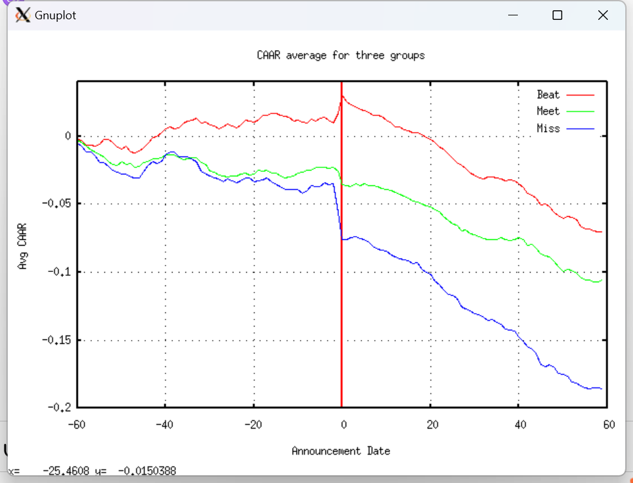
Gnuplot - result
On the Announcement Date, the 'Beat' group sees a notable increase in returns, possibly due to increased buy orders, while the 'Miss' group sees a significant decrease, likely from sell orders.
The 'Beat' group has the highest CAAR; the 'Miss' group has the lowest
Post-announcement, the marked impact on all groups suggests market participants have reacted to the information before the announcement, which is a sign of information leakage
The market conforms to the semi-strong form of the Efficient Market Hypothesis.

Slide 22
Menu
In Menu.cpp, Menu.h
Function print_Options():
1 - Enter N to retrieve 2N+1 days of historical price data for all stocks
2 - Pull information for one stock from one group
3 - Show AAR, AAR-STD, CAAR and CAAR-STD for one group
4 - Show the gnuplot graph with CAAR for all 3 groups
5 - Exit the program
Function MenuCommands():
Create Variables needed in the five functions
Use a while loop to continuously prompt the user for a command until the exit option ('5') is selected

Slide 23
Part 5 - Optimization

Slide 24
5. Optimization: Multithreading
Implemented Multithreading: Enhanced data retrieval speed significantly.
Three Parallel Threads: For 'miss', 'meet', and 'beat' groups.
Data Fetching Efficiency: Concurrent data retrieval from different stock groups.
Performance Improvement: Achieved target runtime of under 4 minutes.
Synchronized Data Processing: Ensured accuracy and consistency across threads.
Impact on Project: Enhanced overall efficiency and responsiveness of the program.

Slide 25
Conclusion
In conclusion, this project offers a sophisticated exploration of the intricate relationship between quarterly earnings reports and stock price movements.
Through adept sorting, bootstrapping, and statistical analysis, we have uncovered nuanced patterns within the financial market. The user-friendly interface, bolstered by data retrieval and gnuplot visualization, facilitates a comprehensive exploration of results.
Our collaborative effort, ensures a systematic approach and a thoroughly tested, integrated final product. Our commitment is to present findings that empower stakeholders with valuable insights, facilitating informed decision-making amidst the dynamic realm of earnings releases.

Slide 26
Thanks!
Reference
[1] Capiński MJ, Zastawniak T. Binomial pricer. In: Numerical Methods in Finance with C . Mastering Mathematical Finance. Cambridge: Cambridge University Press; 2012:1-27. doi:10.1017/CBO9781139017404.002
[2] FRE6883 Financial Computing course slides by Professor Song Tang
[3] Programming platforms and forums and postings

